Slide 1
Network Security:
Denial of Service (DoS)
Tuomas Aura
(includes material by Aapo Kalliola)
T-110.5241 Network security
Aalto University, Nov-Dec 2014

Slide 2
Outline
DoS principles
Packet-flooding attacks on the Internet
Distributed denial of service (DDoS)
Filtering defenses
DoS attacks in the wild
Infrastructural defenses
DoS-resistant protocol design
Research example

Slide 3
DoS principles

Slide 4
Denial of service (DoS)
Goal of denial-of-service (DoS) attacks is to prevent authorized users from accessing a resource, or to reduce the quality of service (QoS) that authorized users receive
Several kinds of DoS attacks:
  Destroy the resource
  Disable the resource with misconfiguration or by inducing an invalid state
  Exhaust the resource or reduce its capacity

Slide 5
Resource destruction or disabling
Examples:
  Cutting cables, bombing telephone exchanges
  Formatting the hard disk
  Crashing a gateway router
These attacks often exploit a software bug, e.g.
  Unchecked buffer overflows
  Teardrop attack: overlapping large IP fragments caused Windows and Linux crashes
Can be prevented by proper design and implementation

Slide 6
Resource exhaustion attacks
Attacker overloads a system to exhaust its capacity
→ DoS attack can never be completely prevented in an open network or open service
  Flooding a web server with requests
  Filling the mailbox with spam
It is difficult to tell the difference between attack and legitimate overload (e.g. Slashdotting, flash crowds)
Some resource in the system under attack becomes a bottleneck i.e. runs out first
  SYN flooding and fixed-size kernel tables
  Public-key cryptography on slow processors
  Apache “range” header request bug
Possible future: in highly elastic cloud services, DoS attack may cause excessive cost instead of failure (?)

Slide 7
Packet-flooding attacks on the Internet

Slide 8
Internet characteristics
Q: Why is the Internet vulnerable to DoS?
  Open network: anyone can join the network, no central control
  Open services: servers want new, unregistered clients to connect
  No global authentication or accountability
  Flat-rate charging
  End to end connectivity (P2P): anyone can send packets to anyone
  Unreliable best-effort routing; congestion causes packet loss
Q: Could these be changed?

Slide 9
Packet-flooding attack
Ping flooding: attacker sends a flood of ping packets (ICMP echo request) to the target
  Unix command ping -f can be used to send the packets
Any IP packets can be used similarly for flooding
Packets can be sent with a spoofed source IP address
Q: Where is the bottleneck resource that fails first?
Typically, packet-flooding exhausts the ISP link bandwidth at the target, in which case the router before the congested link will drop packets
  Other potential bottlenecks: processing capacity of the gateway router, processing capacity of the IP stack at the target host, wireless link capacity of mobile targets

Slide 10
Traffic amplification
Example: Smurf attack in the late 90s used IP broadcast addresses for traffic amplification
Any protocol or service that can be used for DoS amplification with high factor is dangerous! → Non-amplification is a design requirement for all Internet protocols and services

Slide 11
Traffic amplification
Example: Smurf attack in the late 90s used link-broadcast for traffic amplification:
  Attacker sends an ICMP Echo Request (ping) to a broadcast address of a network (e.g. 1.2.3.255)
  Attacker spoofs the source IP address of the ping
  Router at the destination broadcasts the ping to the LAN
  Many nodes in the network respond to the ping
  The target at the spoofed address is flooded by the responses

Slide 12
Traffic reflection
Reflection attack: get others to send packets to the target
  E.g. ping or TCP SYN with spoofed source address
  DNS reflection + amplification: 64 byte query from attacker, ~3000 byte response to target
Hides attack source better than just source IP spoofing

Slide 13
Attack impact
When HR+AR > C, some packets dropped by router
With FIFO or RED queuing discipline at router, dropped packets are selected randomly
Packet loss = (HR+AR-C)/(HR+AR) if HR+AR > C; 0 otherwise
When HR<<AR, packet loss = (AR-C)/AR

Slide 14
Attack impact
Packet loss is measured as %
Packet loss = (HR+AR-C)/(HR+AR) if HR+AR > C; 0 otherwise
When HR<<AR, packet loss ≈ (AR-C)/AR
→ Attacker needs to exceed capacity C to cause packet loss
→ Packet-loss for low-bandwidth honest connections only depends on AR
→ Any AR > C severely reduces TCP throughput for honest client
→ Some honest packets nevertheless make it through:
to cause 90% packet loss, need attack traffic AR = 10 × C,
to cause 99% packet loss, need attack traffic AR = 100 × C

Slide 15
Distributed denial of service (DDoS)

Slide 16
Botnet and DDoS
Attacker controls thousands of compromised computers and launches a coordinated packet-flooding attack

Slide 17
Botnets
Bots (also called zombies) are home or office computers infected with virus, Trojan, rootkit etc.
  Controlled and coordinated by attacker, e.g. over IRC, P2P, Tor
Examples:
  Storm, Conficker at their peak >10M hosts (probably)
  BredoLab ~30M before dismantling
  Cutweil/Pushdo/Pandex around 2M in August 2012
Dangers:
  Overwhelming flooding capacity of botnets can exhaust any link; no need to find special weaknesses in the target
Q: Who are the DDoS attackers?

Slide 18
Who are the (D)DoS attackers?
DDoS attacks started as feud between hackers (to gain control of IRC networks)
Competitive gaming and game servers
  User-hosted servers compete for users
  P2P gaming and chat protocols must not reveal opponent IP addresses
  Continuous attacks against major game servers (almost half of all DoS attacks, but why?)
Blackmailing by criminals, but it is relatively rare
  Botnet owners can make more money from spam, phishing etc.
Politically motivated attacks and rogue governments
  Against Estonia in 2007
  Against South Korea in 2009
  Continuous attacks against controversial political web sites
Attacks against major services and network infrastructure – possibly to test cyber attacks capabilities

Slide 19
Filtering defenses

Slide 20
Filtering DoS attacks
Filtering near the target is the main defense mechanisms against DoS attacks
  Protect yourself → immediate benefit
Firewall configured to drop anything unnecessary:
  Drop protocols and ports no used in the local network
  Drop “unnecessary” protocols such as ping or all ICMP, UDP etc.
  Stateful firewall can drop packets received at the wrong state e.g. TCP packets for non-existing connections
  Firewall can filter dynamically based on ICMP error messages (destination unreachable)
  Application-level firewall could filter at application level; probably too slow under DoS
  (Q: Are there side effects?)

Slide 21
Flooding attack detection and response
Detect and filter probable attack traffic using machine-learning methods
Network-based or host-based attack detection to separate attacks from normal traffic based on traffic characteristics
Limitations of DoS filtering:
  IP spoofing → source IP address is not reliable
  Attacker can evade detection by varying attack patterns and mimicking legitimate traffic
  (Q: Which packet attributes are difficult to mimic?)

Slide 22
Preventing source spoofing
How to prevent spoofing of the source IP address?
Ingress and egress filtering:
  Gateway router checks that packets routed from a local network to the ISP have a local source address
  Generalization: reverse path forwarding
  Selfless defenses without immediate payoff → deployment slow
IP traceback
  Mechanisms for tracing IP packets to their source, mostly academic research and not really deployed
  Limited utility: take-down thought legal channels is slow; automatic blacklisting of attackers can be misused
SYN cookies (we’ll come back to this)

Slide 23
Other (D)DoS defenses
Overprovision (=keep extra capacity)
  More link capacity, beefier server
  Elastic cloud service
Optimize
  Replace resource-consuming content with lighter static content
Distribute
  Deploy more servers or reverse proxies
  Have a true distributed network (Akamai, Cloudflare, ..)
Buy mitigation
  Prolexic, Arbor Networks, …

Slide 24
DoS attacks in the wild

Slide 25
SYN flooding
Attackers goal: make filtering ineffective → honest and attack packets dropped with equal probability
Target destination ports that are open to the Internet, e.g. HTTP (port 80), SMTP (port 25)
Send initial packets → looks like a new honest client
SYN flooding:
  TCP SYN is the first packet of TCP handshake
  Sent by web/email/etc. clients to start communication with a server
  Flooding target or its firewall cannot know which SYN packets are legitimate and which attack traffic → has to treat all SYN packets equally
Can result in server resources getting tied up with half-open connections

Slide 26
DNS flooding
DNS query is sent to UDP port 53 on a DNS server
Attack amplification using DNS:
  Most firewalls allow DNS responses through
  Amplification: craft a DNS record for which 60-byte query can produce 4000-byte responses (fragmented)
  Query the record via open recursive DNS servers that cache the response → traffic amplification happens at the recursive server
  Queries are sent with a spoofed source IP address, the target address → DNS response goes to the target
  Millions of such queries sent by a botnet
2013 survey: >10000 open DNS resolvers over >7000 Ass
Eventually, the open resolvers will be closed

Slide 27
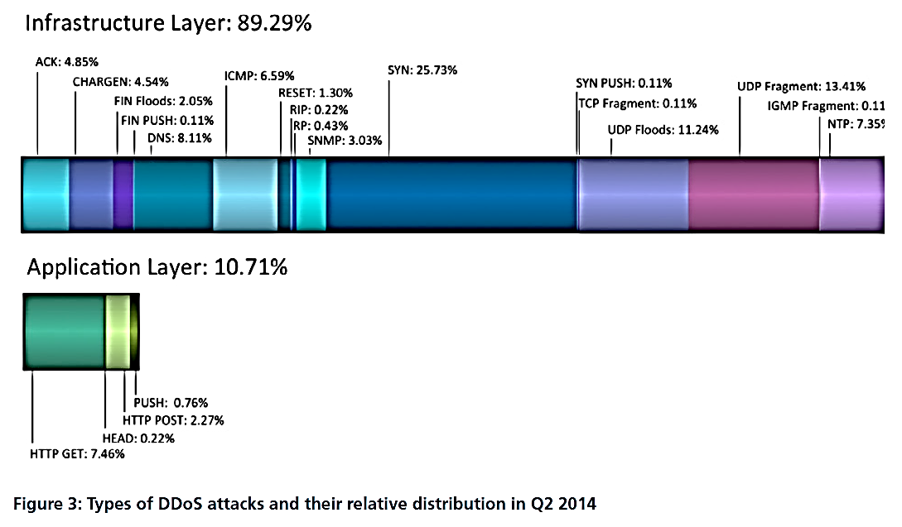
DoS attack types in the wild
(from Prolexic Quarterly Global DDoS Attack Report Q2/2014)

Slide 28
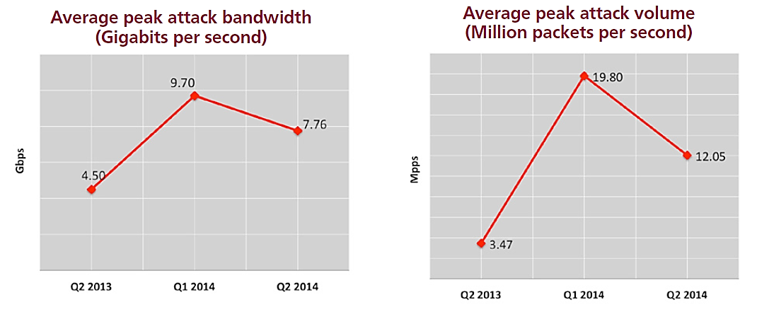
DoS attack types in the wild
(from Prolexic Quarterly Global DDoS Attack Report Q2/2014)

Slide 29
Typical DoS attacks
SYN flooding
  Target an open server port such as 80
  Spoof source IP addresses
  Mimic real source IP address distribution if possible
Mixture of many packet types
  Mainly SYN, DNS, UDP
Time-variable attack
  Change unpredictably between types of packets
  If not spoofing source IP address, change between botnet subsets from which packets are sent
Sudden start and stop and restart at inconvenient times
  The goal is to annoy people

Slide 30
Infrastructural defenses

Slide 31
Over-provisioning
Increase bottleneck resource capacity to cope with attacks
Recall:
  Packet loss = (HR+AR-C)/(HR+AR) if HR+AR > C; 0 otherwise
  When HR<<AR, packet loss = (AR-C)/AR
→ Does doubling link capacity C help? Depends on AR:
  If attacker sends 100×C to achieve 99% packet loss, doubling C will result in only 98% packet loss
  If attacker sends 10×C to achieve 90% packet loss, doubling C will result in only 80% packet loss
  If attacker sends 2×C to achieve 50% packet loss, doubling C will result in (almost) zero packet loss

Slide 32
QoS routing
QoS routing mechanisms can guarantee service quality to some important clients and services
Resource reservation, e.g. Intserv, RSVP
Traffic classes, e.g. Diffserv, 802.1Q
  Protect important clients and connections by giving them a higher traffic class
  Protect intranet traffic by giving packets from Internet a lower class
Prioritizing existing connections
  After TCP handshake or after authentication
Potential problems:
  How to take into account new honest clients?
  Cannot trust traffic class of packets from untrusted sources
  Political opposition to Diffserv: net neutrality

Slide 33
Some research proposals
IP traceback to prevent IP spoofing
Pushback for scalable filtering
Capabilities, e.g. SIFF, for prioritizing authorized connections at routers
New Internet routing architectures:
  Overlay routing (e.g. Pastry, i3), publish-subscribe models (e.g. PSIRP), software-defined networking (SDN)
  Claimed DoS resistance remains to be fully proven

Slide 34
DoS-resistant protocol design

Slide 35
Protocol design goals
Process attack packets quickly at the end host
Prevent attacker from creating excessive state data at the target
Avoid doing expensive cryptographic computation
Make it easy for a firewall or proxy to filter traffic

Slide 36
Cryptographic authentication
Idea: authenticate packets and allow only authorized ones
  IPsec ESP
  Filter at firewall or end host
Problems:
  Requires a system for authorizing clients
  First packet of the authentication protocol becomes the weak point
➔Difficult to use authentication to prevent DoS

Slide 37
Stateless handshake (IKEv2)
Goal: verify client IP address before server commits resources
Responder stores per-client state only after it has received valid cookie:
COOKIE = hash(Kr , initiator and responder IP addresses)
where Kr is a periodically changing key known only by responder
→ initiator cannot spoof its IP address
No state-management problems caused by spoofed initial messages
(Note: memory size is not the issue)

Slide 38
TCP SYN Cookies
Random initial sequence numbers in TCP protect against IP spoofing: client must receive msg 2 to send a valid msg 3
SYN cookie: stateless implementation of the handshake;
y = hash(K_{server}, client addr, port, server addr, port)
where K_{server} is a key known only to the server.
Server does not store any state before receiving and verifying the cookie value in msg 2
Sending the cookie as the initial sequence number; in new protocols, a separate field would be used for the cookie

Slide 39
Client puzzle (HIP)
RFC 5201,
based on research paper by Aura, Nikander, Leiwo 2001
Client “pays” for server resources by solving a puzzle first
Puzzle is brute-force reversal of a K-bit cryptographic hash; puzzle difficulty K can be adjusted according to server load
Server does not do public-key operations before verifying the solution
Server can also be stateless; puzzle created like stateless cookies

Slide 40
Prioritizing old clients
One way to cope with overload: give priority to old clients and connections, reject new ones
Filtering examples:
  Remember client IP addresses that have completed sessions previously, completed handshake, or authenticated successfully
  Prioritize TCP connections from address prefixes that have had many clients over long time
  (bots are scattered all over the IP address space)
Protocol design:
  Give previous clients a credential (e.g. key) that can be used for reconnecting

Slide 41
Research topic:
Denial-of-service mitigation for Internet services
Aapo Kalliola, Tuomas Aura and Sanja Šćepanović
Nordsec 2014 conference best paper award

Slide 42
Attack scenario
A web server is under packet or request flooding (D)DoS attack
Server or link capacity exceeded ➔ some of the incoming traffic must be dropped at upstream router or at the server

Slide 43
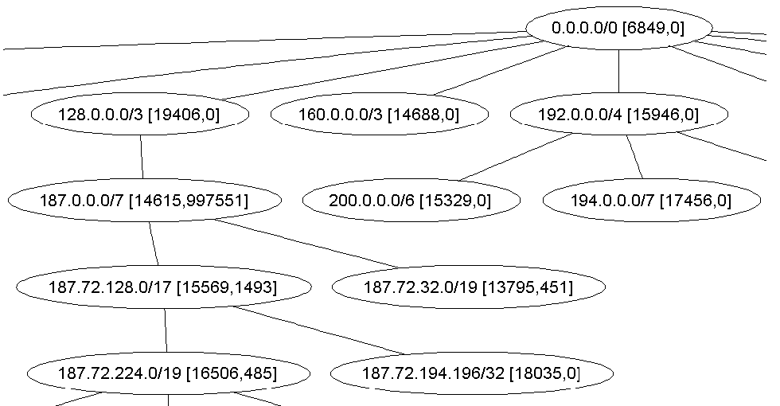
Defence method
Principle:
  Learn a model of the normal traffic
  Filter traffic during the attack: serve packets or request that resemble the normal traffic
Traffic model: clusters of client IP addresses with equal amount of traffic
Filtering criterion: during the attack, prioritize clusters where the traffic increase % is the smallest (provably optimal filtering strategy)

Slide 44
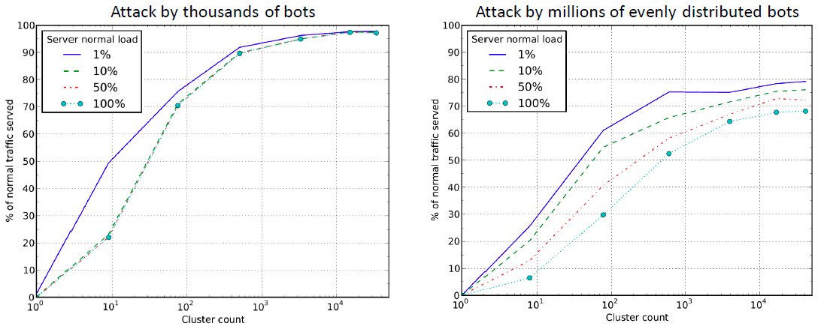
Simulation results
Denial-of-service mitigation for Internet
services
Simulations help test and optimize the algorithms

Slide 45
Implementation architecture

Slide 46
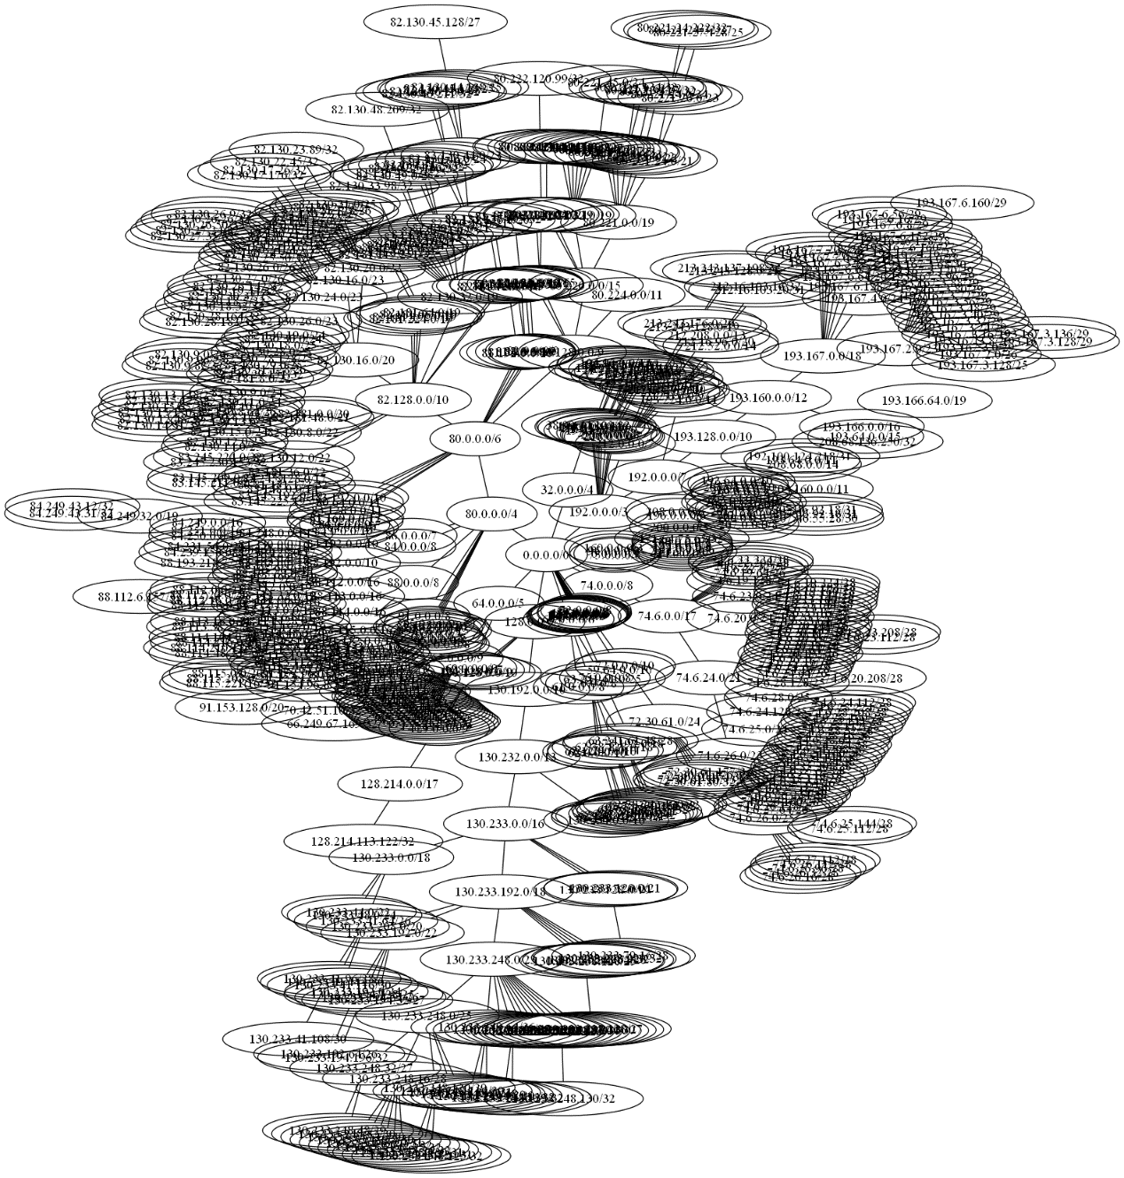
Clusters
{"action":"allow", "priority":1, "subnet":"80.221.20.0/23"},
{"action":"allow", "priority":1, "subnet":"74.6.27.76/30"},
{"action":"allow", "priority":1, "subnet":"82.130.12.55/32"},
{"action":"allow", "priority":1, "subnet":"85.240.0.0/12"},
{"action":"allow", "priority":1, "subnet":"193.167.6.4/32"},
{"action":"allow", "priority":1, "subnet":"74.6.23.228/30"},
{"action":"allow", "priority":1, "subnet":"74.6.28.76/31"},
{"action":"allow", "priority":1, "subnet":"193.185.55.253/32"},
{"action":"allow", "priority":1, "subnet":"74.6.28.158/32"},
{"action":"allow", "priority":1, "subnet":"82.130.21.152/32"},
{"action":"allow", "priority":1, "subnet":"130.233.248.51/32"},
{"action":"allow", "priority":1, "subnet":"213.248.0.0/13"},
{"action":"allow", "priority":1, "subnet":"82.181.32.0/19"},
{"action":"allow", "priority":1, "subnet":"74.6.23.31/32"},
{"action":"allow", "priority":1, "subnet":"82.130.13.181/32"},
{"action":"allow", "priority":1, "subnet":"74.6.28.216/32"},
{"action":"allow", "priority":1, "subnet":"82.130.17.0/28"},
{"action":"allow", "priority":1, "subnet":"130.233.120.38/32"},
{"action":"allow", "priority":1, "subnet":"213.112.0.0/14"},
{"action":"allow", "priority":1, "subnet":"130.233.248.197/32"},
{"action":"allow", "priority":1, "subnet":"74.6.25.112/29"},
{"action":"allow", "priority":1, "subnet":"83.245.230.153/32"},
{"action":"allow", "priority":1, "subnet":"130.233.248.127/32"},
{"action":"allow", "priority":1, "subnet":"80.221.24.231/32"},
{"action":"allow", "priority":1, "subnet":"88.195.119.245/32"},
{"action":"allow", "priority":1, "subnet":"82.130.37.108/30"},
{"action":"allow", "priority":1, "subnet":"130.233.194.52/32"},
{"action":"allow", "priority":1, "subnet":"130.233.238.32/28"},
{"action":"allow", "priority":1, "subnet":"82.181.152.0/22"},
{"action":"allow", "priority":1, "subnet":"193.167.4.14/31"},
{"action":"allow", "priority":1, "subnet":"88.112.128.0/20"},
{"action":"allow", "priority":1, "subnet":"91.155.84.0/22"},
{"action":"allow", "priority":1, "subnet":"193.167.7.220/30"},
{"action":"allow", "priority":1, "subnet":"82.130.34.64/26"},
{"action":"allow", "priority":1, "subnet"a:"193.167.7.216/30"},
{"action":"allow", "priority":1, "subnet":"130.233.194.33/32"},
{"action":"allow", "priority":1, "subnet":"74.6.28.142/31"},
{"action":"allow", "priority":1, "subnet":"84.240.64.0/20"},

Slide 47
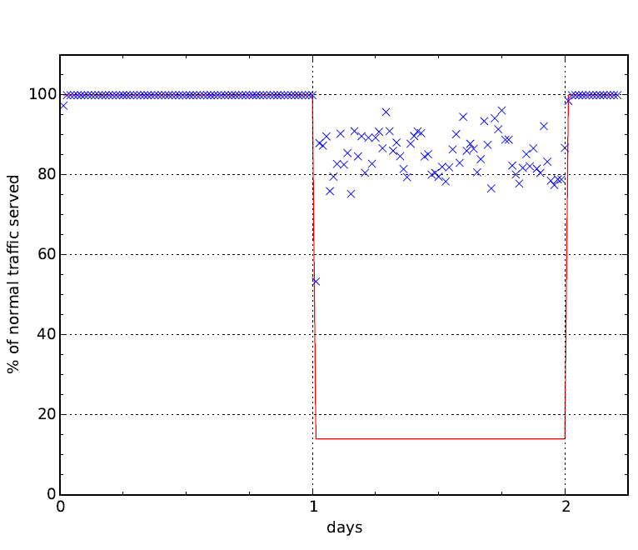
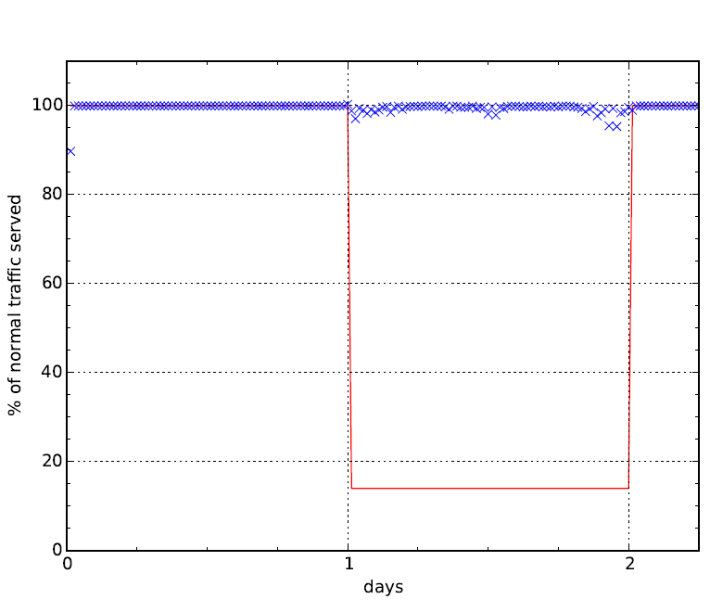
Experimental results
Spoofed random IP attacker
Single IP attacker
Experiments with 10 GG OpenFlow switch

Slide 48
Further reading
DDoS attacks and defense mechanisms: classification and state-of-the-art, Douligeris C. and Mitrokotsa A.
  http://www.sciencedirect.com/science/article/pii/S1389128603004250
Prolexic Quarterly DDoS Attack Report (requires registration)
  http://ww.prolexic.com/attack-report

