Slide 1
Network Security: Denial of Service (DoS)
Tuomas Aura / Aapo Kalliola
T-110.5241 Network security Aalto University, Nov-Dec 2012

Slide 2
Outline
DoS principles
Packet-flooding attacks on the Internet
Distributed denial of service (DDoS)
Filtering defenses
Most effective attack strategies
Infrastructural defenses
DoS-resistant protocol design
Research example

Slide 3
DoS principles

Slide 4
Denial of service (DoS)
Goal of denial-of-service (DoS) attacks is to prevent authorized users from accessing a resource, or to reduce the quality of service (QoS) that authorized users receive
Several kinds of DoS attacks:
Destroy the resource
Disable the resource with misconfiguration or by inducing an invalid state
Exhaust the resource or reduce its capacity

Slide 5
Resource destruction or disabling
Examples:
Cutting cables, bombing telephone exchanges
Formatting the hard disk
Crashing a gateway router
These attacks often exploit a software bug, e.g.
Unchecked buffer overflows
Teardrop attack: overlapping large IP fragments caused Windows and Linux crashes
Can be prevented by proper design and implementation

Slide 6
Resource exhaustion attacks
Attacker overloads a system to exhaust its capacity → never possible to prevent completely in an open network
Examples:
Flooding a web server with requests
Filling the mailbox with spam
It is difficult to tell the difference between attack and legitimate overload (e.g. Slashdotting, flash crowds)
For highly scalable services, need to try to detect attacks
Some resource in the system under attack becomes a bottleneck i.e. runs out first → Attacks can exploit a limited bottleneck resource:
SYN flooding and fixed-size kernel tables
Public-key cryptography on slow processors
Apache “range” header request bug

Slide 7
Packet-flooding attacks on the Internet

Slide 8
Internet characteristics
Q: Why is the Internet vulnerable to DoS?
Open network: anyone can join, no central control
End to end connectivity: anyone can send packets to anyone
No global authentication or accountability
Flat-rate charging (mostly)
Unreliable best-effort routing; congestion causes packet loss
Q: Could these be changed?

Slide 9
Packet-flooding attack
Ping flooding: attacker sends a flood of ping packets (ICMP echo request) to the target
Unix command ping -f can be used to send the packets
Any IP packets can be used similarly for flooding
Packets can be sent with a spoofed source IP address
Q: Where is the bottleneck resource that fails first?
Typically, packet-flooding exhausts the ISP link bandwidth, in which case the router before the congested link will drop packets
Other potential bottlenecks: processing capacity of the gateway router, processing capacity of the IP stack at the target host

Slide 10
Traffic amplification
Example: Smurf attack in the late 90s used IP broadcast addresses for traffic amplification
Any protocol or service that can be used for DoS amplification is dangerous! → Non-amplification is a key design requirement

Slide 11
Traffic amplification
Example: Smurf attack in the late 90s used link-broadcast for traffic amplification:
Attacker sends an ICMP Echo Request (ping) to a broadcast address of a network (e.g. 1.2.3.255)
Attacker spoofs the source IP address of the ping
Router at the destination broadcasts the ping to the LAN
Many nodes in the network respond to the ping
The target at the spoofed address is flooded by the responses

Slide 12
Traffic reflection
Reflection attack: get others to send packets to the target
E.g. ping or TCP SYN with spoofed source address
DNS reflection + amplification: 64 byte query from attacker, ~3000 byte response to target
Hides attack source better than just source IP spoofing

Slide 13
Attack impact
When HR+AR > C, some packets dropped by router
With FIFO or RED queuing discipline at router, dropped packets are selected randomly
Packet loss = (HR+AR-C)/(HR+AR) if HR+AR > C; 0 otherwise
When HR<<AR, packet loss = (AR-C)/AR

Slide 14
Attack impact
Packet loss = (HR+AR-C)/(HR+AR) if HR+AR > C; 0 otherwise
When HR<<AR, packet loss = (AR-C)/AR
→ Attacker needs to exceed C to cause packet loss
→ Packet-loss for low-bandwidth honest connections only depends on AR
→ Any AR > C severely reduces TCP throughput for honest client
→ Some honest packets nevertheless make it through:
to cause 90% packet loss, need attack traffic AR = 10 × C,
to cause 99% packet loss, need attack traffic AR = 100 × C

Slide 15
Distributed denial of service (DDoS)

Slide 16
Botnet and DDoS
Attacker controls thousands of compromised computers and launches a coordinated packet-flooding attack

Slide 17
Botnets
Bots (also called zombies) are home or office computers infected with virus, Trojan, rootkit etc.
Controlled and coordinated by attacker, e.g. over IRC, P2P, Tor
Hackers initially attacked each other; now used by criminals
Examples:
Storm, Conficker at their peak >10M hosts (probably)
BredoLab ~30M before dismantling
Cutweil/Pushdo/Pandex around 2M in August
Dangers:
Overwhelming flooding capacity of botnets can exhaust any link; no need to find special weaknesses in the target
Q: Are criminals interested in DDoS if they can make money from spam and phishing? What about politically motivated attacks or rogue governments?

Slide 18
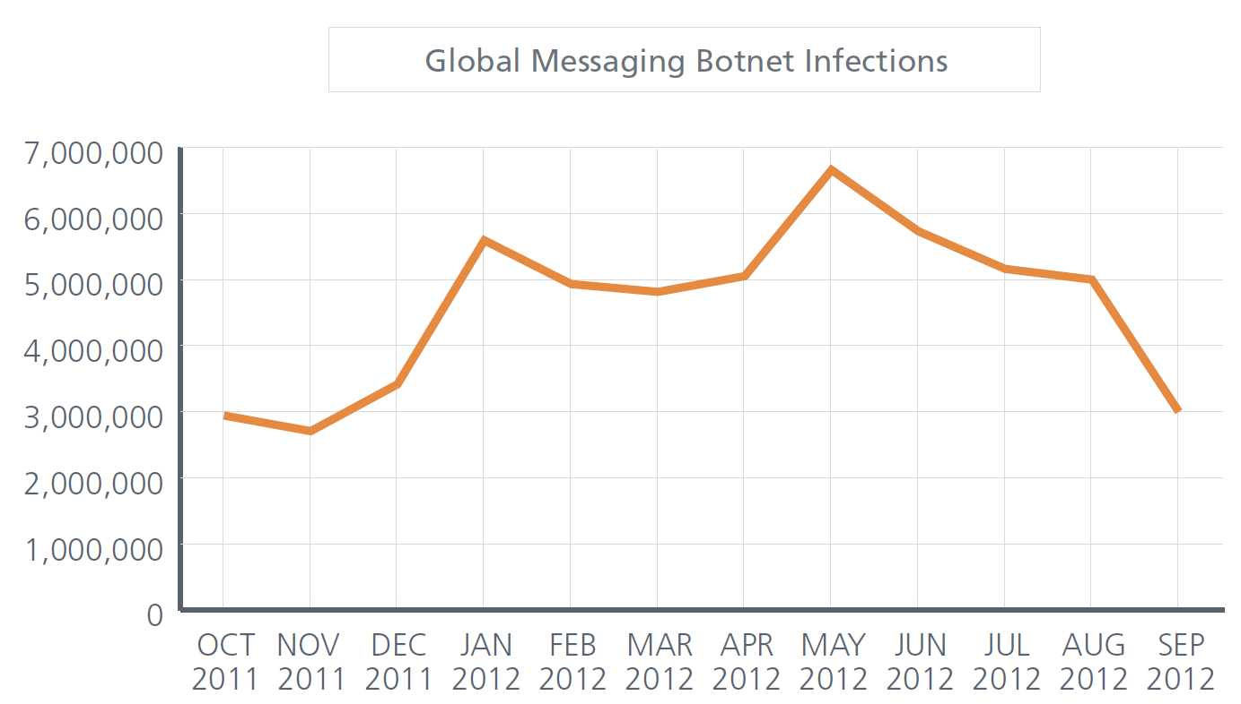
Spambot infections
(from McAfee Quarterly Threat Report Q3/2012)

Slide 19
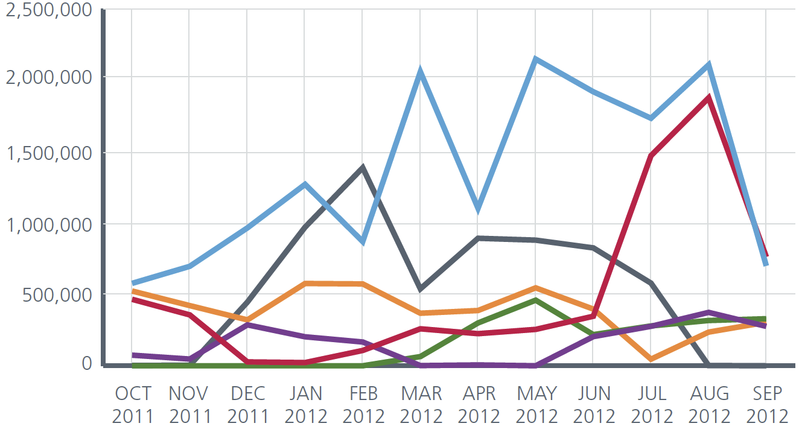
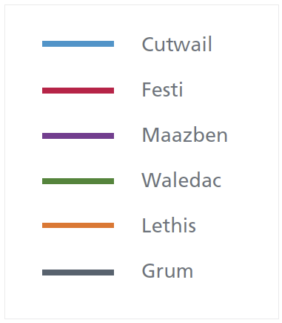
Different botnets
(from McAfee Quarterly Threat Report Q3/2012)

Slide 20
Not the whole picture...
Only spamming botnets shown
Lots of different botnets
~1000 Zeus C&C servers (most prolific DIY botnet SW)
~300 SpyEye C&C servers
1-2 million ZeroAccess bots (ad-click fraud)
etc..
DDoS as a service – $50 for 24-hour DDoS

Slide 21
Botnets in news
“Officials see Iran, not outrage over film, behind cyber attacks on US banks” (NBC News/20.9.2012)
“DDoS attacks: 150Gb per second and rising” (ZDNet/2.10.2012)
“DDoS sinks The Pirate Bay” (itnews/14.10.2012)
”Anti-Kremlin website complains of DDoS attacks” (TheRegister/5.12.2011)
etc.
Burma DDoS’d in 2010 before elections
International bandwidth ~45Mbps, attack 10-15Gbps

Slide 22
Filtering defenses

Slide 23
Filtering DoS attacks
Filtering near the target is the main defense mechanisms against DoS attacks
Protect yourself → immediate benefit
Configure firewall to drop anything not necessary:
Drop protocols and ports no used in the local network
Drop “unnecessary” protocols such as ping or all ICMP, UDP etc.
Stateful firewall can drop packets received at the wrong state e.g. TCP packets for non-existing connections
Application-level firewall could filter at application level; probably too slow under DoS
Filter dynamically based on ICMP destination-unreachable messages
(Q: Are there side effects?)

Slide 24
Flooding detection and response
Filter probable attack traffic using machine-learning methods
Network or host-based intrusion detection to separate attacks from normal traffic based on traffic characteristics
Limitations:
IP spoofing → source IP address not reliable for individual packets
Attacker can evade detection by varying attack patterns and mimicking legitimate traffic
(Q: Which attributes are difficult to mimic?)

Slide 25
Preventing source spoofing
How to prevent spoofing of the source IP address?
Ingress and egress filtering:
Gateway router checks that packets routed from a local network to the ISP have a local source address
Generalization: reverse path forwarding
Selfless defenses without immediate payoff → deployment slow
IP traceback
Mechanisms for tracing IP packets to their source
Limited utility: take-down thought legal channels is slow; automatic blacklisting of attackers can be misused
SYN cookies (we’ll come back to this)

Slide 26
Other defenses
Extra capacity
More link capacity, beefier server
Optimize
Replace resource-consuming content with lighter static content
Distribute
Deploy more servers or reverse proxies
Have a true distributed network (Akamai, Cloudflare , ..)
Buy mitigation
Prolexic, Arbor Networks, ..

Slide 27
Most effective attack strategies

Slide 28
SYN flooding
Attackers goal: make filtering ineffective → honest and attack packets dropped with equal probability
Target destination ports that are open to the Internet, e.g. HTTP (port 80), SMTP (port 25)
Send initial packets → looks like a new honest client
SYN flooding:
TCP SYN is the first packet of TCP handshake
Sent by web/email/ftp/etc. clients to start communication with a server
Flooding target or firewall cannot know which SYN packets are legitimate and which attack traffic → has to treat all SYN packets equally

Slide 29
DNS flooding
DNS query is sent to UDP port 53 on a DNS server
Attack amplification using DNS:
Most firewalls allow DNS responses through
Amplification: craft a DNS record for which 60-byte query can produce 4000-byte responses (fragmented)
Query the record via open recursive DNS servers that cache the response → traffic amplification happens at the recursive server
Queries are sent with a spoofed source IP address, the target address → DNS response goes to the target
Millions of such queries sent by a botnet

Slide 30
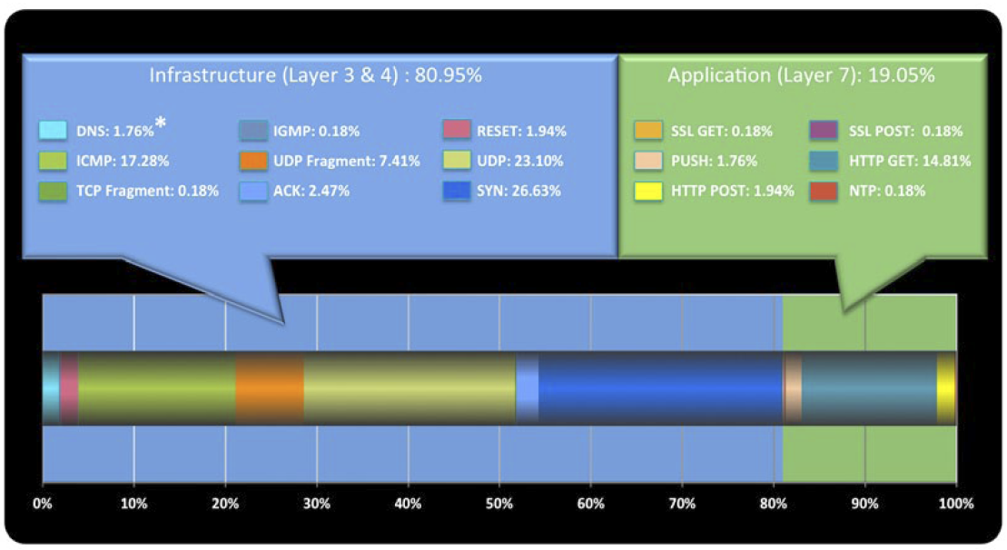
In practise
(from Prolexic Quarterly Global DDoS Attack Report Q2/2012)

Slide 31
Infrastructural defenses

Slide 32
Over-provisioning
Increase bottleneck resource capacity to cope with attacks
Recall:
Packet loss = (HR+AR-C)/(HR+AR) if HR+AR > C; 0 otherwise
When HR<<AR, packet loss = (AR-C)/AR
→ Does doubling link capacity C help? Depends on AR:
If attacker sends 100×C to achieve 99% packet loss, doubling C will result in only 98% packet loss
If attacker sends 10×C to achieve 90% packet loss, doubling C will result in only 80% packet loss
If attacker sends 2×C to achieve 50% packet loss, doubling C will result in (almost) zero packet loss

Slide 33
QoS routing
QoS routing mechanisms can guarantee service quality to some important clients and services
Resource reservation, e.g. Intserv, RSVP
Traffic classes, e.g. Diffserv, 802.1Q
Protect important clients and connections by giving them a higher traffic class
Protect intranet traffic by giving packets from Internet a lower class
Prioritizing existing connections
After TCP handshake or after authentication
Potential problems:
How to take into account new honest clients?
Cannot trust traffic class of packets from untrusted sources
Political opposition to Diffserv (net neutrality lobby)

Slide 34
Some research proposals
IP traceback to prevent IP spoofing
Pushback for scalable filtering
Capabilities, e.g. SIFF, for prioritizing authorized connections at routers
New Internet routing architectures:
Overlay routing (e.g. Pastry, i3), publish-subscribe models (e.g. PSIRP)
Claimed DoS resistance remains to be fully proven
Problems?

Slide 35
DoS-resistant protocol design

Slide 36
Protocol design goals
Process attack packets quickly at the end host
Prevent attacker from creating excessive state data at the target
Avoid doing expensive cryptographic computation
Make it easy for a firewall or proxy to do filter traffic

Slide 37
Stateless handshake (IKEv2)
Responder stores per-client state only after it has received valid cookie:
COOKIE = hash(Kr , initiator and responder IP addresses)
where Kr is a periodically changing key known only by responder
→ initiator cannot spoof its IP address
No state-management problems caused by spoofed initial messages
(Note: memory size is not the issue)

Slide 38
TCP SYN Cookies
Random initial sequence numbers in TCP protect against IP spoofing: client must receive msg 2 to send a valid msg 3
SYN cookie: stateless implementation of the handshake;
y = hash(K_{server}, client addr, port, server addr, port)
where K_{server} is a key known only to the server.
Server does not store any state before receiving and verifying the cookie value in msg 2
Sending the cookie as the initial sequence number; in new protocols, a separate field would be used for the cookie

Slide 39
Client puzzle (HIP)
Client “pays” for server resources by solving a puzzle first
Puzzle is brute-force reversal of a K-bit cryptographic hash; puzzle difficulty K can be adjusted according to server load
Server does not do public-key operations before verifying the solution
Server can also be stateless; puzzle created like stateless cookies

Slide 40
Prioritizing old clients
One way to cope with overload: give priority to old clients and connections, reject new ones
Filtering examples:
Remember client IP addresses that have completed sessions previously, completed handshake, or authenticated successfully
Prioritize TCP connections from address prefixes that have had many clients over long time (bots are scattered all over the IP address space)
Protocol design:
Give previous clients a credential (e.g. key) that can be used for reconnecting

Slide 41
Cryptographic authentication
Idea: authenticate packets and allow only authorized ones
IPsec ESP
Filter at firewall or end host
Problems:
Requires a system for authorizing clients
First packet of the authentication protocol becomes the weak point
➔Difficult to use authentication to prevent DoS

Slide 42
Research example: Automated traffic filtering

Slide 43
Scenario
Number of normal users dwarfed by the attacker bot count
x10 ... x1000000
Attacker is a geographically distributed botnet
Difficult to differentiate manually from normal users based on traffic rates or geolocation
Attacker sends valid requests to the server, aiming to overload the server capacity
CPU, memory, database, uplink bandwidth

Slide 44
What to do we have?
Normal traffic features
Source IP, Destination IP, TTL ...
Requested resource
Request frequency
Request consistency
Attack ←→ Normal dissimilarities
Source hierarchy
Accessed resource
etc?

Slide 45
Learning and filtering
Create a model of the normal traffic
Detect attack
Start filtering requests
Revert to normal operations once the attack has subsized
Results: >50% of legitimate traffic served (in simulations)
DDoS vs. Flash crowd?

Slide 46
Hierarchical cluster model
Normal traffic model = hierarchical clusters of request or packets based on features, mainly source IP address
Provably optimal filtering strategy:
Cluster priority = ratio of normal and current traffic in cluster
During attack, serve requests in clusters with highest priority

Slide 47
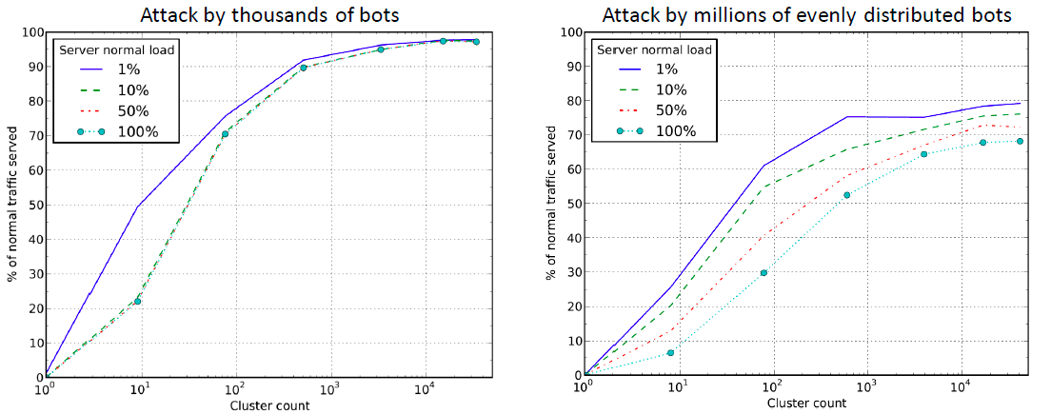
Simulations
Variable server normal load, attack traffic exceeds normal traffic by a factor of 10e6.

Slide 48
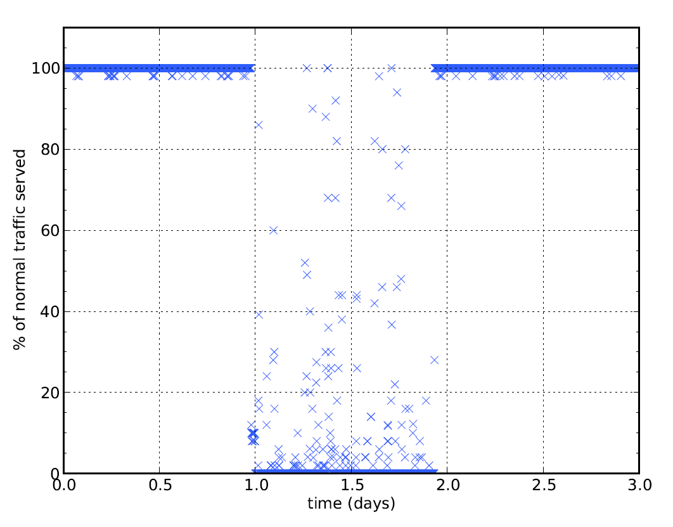
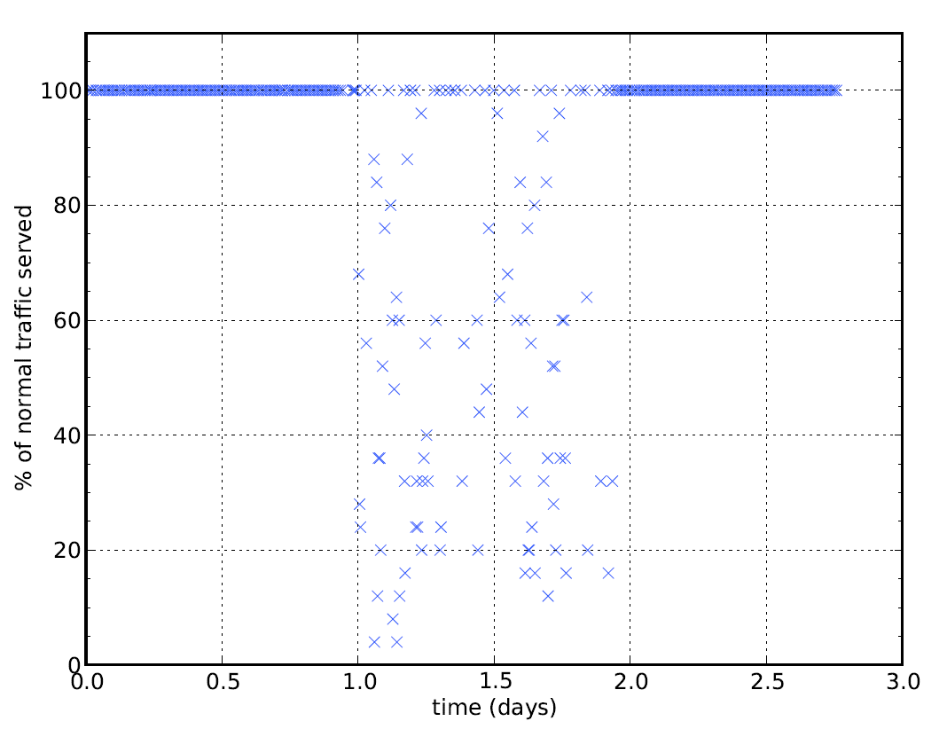
Implementation tests
Attack scenario: server runs normally at 50 % capacity; DoS attack exceeds 10 times the server capacity → ~10% of honest requests served
Filtering deployed → 40..100 % of honest request served
unprotected
protected

Slide 49
Further reading
DDoSattacks and defense mechanisms: classification and state-of-the-art, Douligeris C. and Mitrokotsa A.
http://www.sciencedirect.com/science/article/pii/S1389128603004250
Prolexic Q2 2012 DDoS Attack Report (requires registration)
http://ww.prolexic.com/attack-report
DDoS and other anomalous web traffic behavior in selected countries, Banks K.B. et al
http://ieeexplore.ieee.org/xpls/abs_all.jsp?arnumber=6197004&tag=1

